Slide 1
B810Z
【 Dual head high performance direct injection plasma equipment specification 】

Slide 2
目录 CONTENTS
1 .equipment introduction ...................................................................................................................................................... 1
2 . technical specification ...............................................................................................................................................2
3 .configuration list ..................................................................................................................................................... 4
4 . Applicable substrate ..................................................................................................................................................... 5
5 . announcements ..................................................................................................................................................... 6
6 . Head detail ......................................................................................................................................... 7

Slide 3
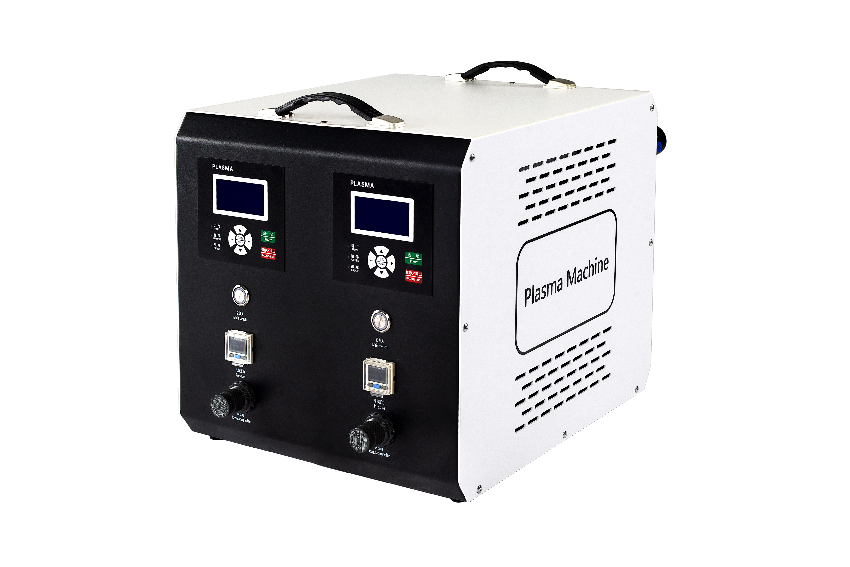
1. Equipment introduction
1

Slide 4
The low temperature magnetic swirling plasma processor is composed of plasma generator, gas conveying system, pressure protection system and plasma nozzle. The plasma generator generates high voltage and high frequency energy in the nozzle steel pipe activated and controlled glow discharge, which ionizes the air and produces low temperature plasma. The plasma is sprayed to the surface of the workpiece with the help of compressed air. When the plasma meets the surface of the treated object, a series of chemical effects and physical changes are generated, and the surface is cleaned and hydrogen carbide dirt is removed. Such as grease, auxiliary additives, etc., according to the composition of the material, its surface molecular chain structure has been changed. Free groups such as hydroxyl group and carbon group are established, which can promote the adhesion of various coating materials, and are optimized for adhesion and paint application. In the same effect, the application of plasma treatment surface can obtain a very thin high-tension coating surface, without the need for any other mechanical, chemical treatment and other strong acting components to increase the adhesion. Through low temperature plasma surface treatment, a variety of physical and chemical changes occur on the surface of the material, or it produces etching and roughness, or forms a dense cross-linked layer, or introduces oxygen polar groups, so that the hydrophilicity, cohesiveness, dyeability, biocompatibility and electrical properties are improved respectively. When the surface of the material is treated under appropriate process conditions, the surface morphology of the material changes significantly, and a variety of oxygen-containing groups are introduced to make the surface change from non-polar and difficult to stick to a certain polarity, easy to stick and hydrophilic, which is conducive to bonding, coating and printing.
2

Slide 5
2. Technical parameters
voltage | 220V
rate of work | 2000w
working pressure | 0.25mpa-0.35mpa
frequency | 18khz-60khz
Main box size | 392*590.52*422.36
Main box weight | 26kg
Head weight | 1.65kg*2
Instantaneous temperature when moving | Close to human body temperature (about 50° when moving)
3

Slide 6
3. Configuration list
serial number | parets name | brand | quantity | remark
1 | power switch | 深圳/蓝波 | 2 | All metal process manufacturing
2 | Pressure shunt assembly | 台湾/亚德客 | 2
3 | Pressure monitoring switch | 台湾/亚德客 | 2
4 | breaker | 正泰 | 2 | Industrial grade circuit protection
5 | EMI filter | 台湾YUNSANDA | 1 | Effectively filter out electromagnetic interference
6 | Gun head insulating ceramic (set) | 专业厂家定制 | 2 | High temperature and high pressure resistance
7 | nozzle | 专业厂家定制 | 2 | High temperature and high pressure resistance
8 | high-voltage transformer | 台湾定制 | 2 | High temperature and high pressure resistance
9 | spearhead | 专业厂家定制 | 2 | 99%Alumina content
10 | switching power supply | 台湾/明伟 | 1
11 | Motor/Driver | 专业厂家定制 | 2 | Low noise
12 | Main CPU chip | 英国ARM | 2
13 | driver chip | 韩国ST | 8
14 | IGBT | 德国Infineon | 8
15 | cooling fan | 台湾Bi-sonic | 4
16 | All metal case | 专业厂家定制 | 1 | Effective shielding of electromagnetic interference
17 | Main power cord | 深圳/绿联 | 1
18 | Gun head bracket | 定制 | 2
4

Slide 7
4. Applicable substrate
Applicable substrate | 1.塑胶材质（PE、PP、PS、PVC、ABS、PMMA、PA、POM、PBT、PPS、PEEK、PAR、PC、TPU、TPS以及以上混合料等）
 | 2.五金（ABS、PC等）
 | 3.玻璃
 | 4.陶瓷
 | 5.涂层面
Not applicable substrate | 1.个别硅胶制品
 | 2.铁氟龙材质
 | 3.鞋材制品
effect | 1.超精细清洁去除表层颗粒杂质提升界面张力 2.提高表面达因值以及增强粘接牢度。 3.高效、免擦拭、提升生产加工速率、控制成本。 替代传统化学药品，不会破坏产品基材，高效、环保、无耗材。
5

Slide 8
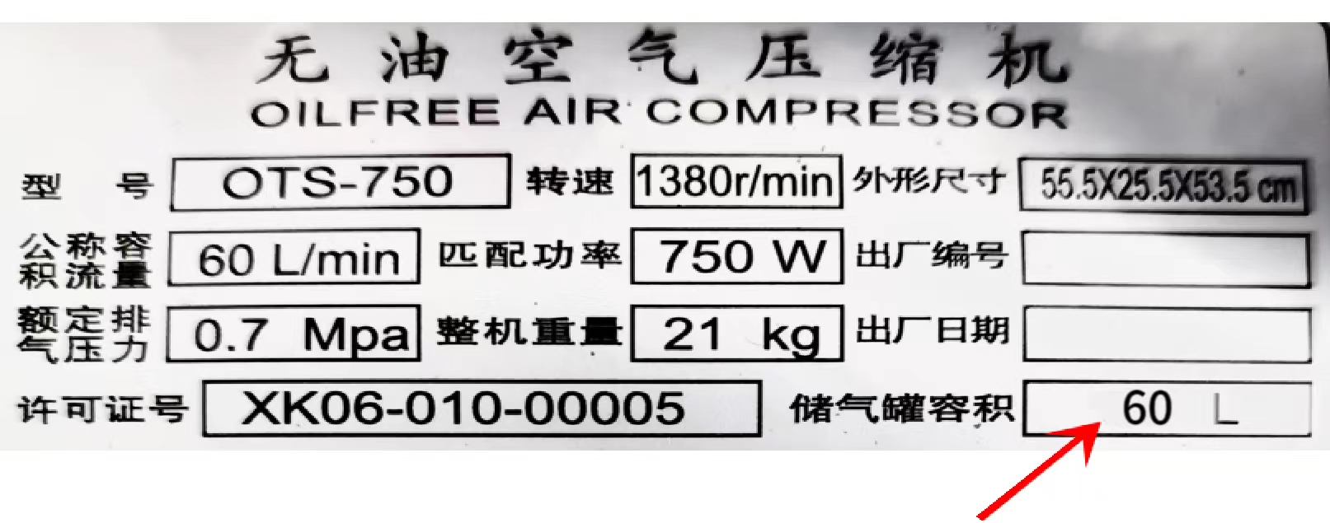
五、注意事项
设备正常工作需要具备以下条件：
1.Ventilation (Compressed air, air compressor volume is recommended more than 60L.)
2.Electricity (household electricity 220v)
3.effectively grounded
6

Slide 9
六、枪头详情
处理时喷嘴距离产品1-1.5cm
枪头微调支架可上下调节高度
7

Slide 10
1.During the shelf life, free replacement of damaged parts under normal use.
2.If the operation fails to meet the scope of the equipment, resulting in damage to relevant parts, the company shall not be liable for compensation.
3.In case of damage caused by earthquake, fire, typhoon, tsunami and other force majeure disasters, the company shall not be liable for compensation。
4.If the equipment is damaged directly or indirectly by non-use of original parts, the company shall not be liable for compensation.
5.If the equipment is damaged or defective due to improper design, the company shall not be liable for compensation.
6.After the warranty period, your company is responsible for the consumables and service costs required to replace the parts.

